Slide 1


Rubina Parveen
9th Nov, 2024

Slide 2

Outline
Executive Summary
Introduction
Methodology
Results
Conclusion
Appendix

Slide 3
Executive Summary
Summary of methodologies
Data Collection through API
Data Collection with Web Scraping
Data Wrangling
Exploratory Data Analysis with SQL
Exploratory Data Analysis with Data Visualization
Interactive Visual Analytics with Folium
Machine Learning Prediction
Summary of all results
Exploratory Data Analysis result
Interactive analytics in screenshots
Predictive Analytics result

Slide 4
Introduction
Project background and context
SpaceX offers Falcon 9 rocket launches for a competitive price of $62 million, compared to over $165 million for launches from other providers. A significant factor in SpaceX's cost efficiency is the ability to reuse the first stage of the rocket. Accurately predicting whether the first stage will successfully land after launch is crucial, as this directly impacts the overall cost of a mission. This predictive capability could be valuable for competitors looking to challenge SpaceX by allowing them to better assess costs and bidding strategies for future launch contracts.
The objective of this project is to build a comprehensive machine learning pipeline that predicts the likelihood of the Falcon 9's first stage landing successfully. This will involve data collection, data wrangling, feature engineering, model selection, and evaluation to deliver an accurate and reliable prediction model that supports strategic decision-making for potential industry competitors.
Problems you want to find answers
Can we predict the likelihood of the first stage landing successfully based on available launch data?
What are the critical factors influencing the success of a first-stage landing?
How accurately can our model predict successful landings, and what performance metrics should we focus on?
How can this prediction model help competitors in assessing potential costs or bidding strategies?

Slide 5

Section 1

Slide 6
Methodology
Executive Summary
Data collection methodology:
SpaceX launch data collected from spaceX API (https://api.spacexdata.com/v4/launches/past) and web scrapping using Beautiful Soup
Perform data wrangling
Falcon 9 data extracted cleaned, missing values are replaced with the appropriate values.
Perform exploratory data analysis (EDA) using visualization and SQL
Perform interactive visual analytics using Folium and Plotly Dash
Perform predictive analysis using classification models
SVM, Classification Trees and Logistic Regression used for analysis

Slide 7
Data Collection
Data collection for this project involved leveraging both the SpaceX API and web scraping techniques to gather comprehensive information on Falcon 9 launch records.
API Data Collection:
GET request to SpaceX API done to retrieve detailed launch data.
Response decoded as JSON using the .json() function, and then used .json_normalize() to flatten and convert the JSON data into a structured Pandas DataFrame, making it suitable for analysis.
Data cleaning and processing:
Data was cleaned, addressing any inconsistency and inspected for missing value.
Missing values were filled or imputed as needed to ensure data completeness and integrity, which improved the dataset's usability for modeling.
Web scrapping with BeautifulSoup:
Web scrapped Wikipedia pages to extract additional information on Falcon 9 launch records.
Used BeautifulSoup to identify and parse HTML tables containing historical launch information and converted these tables into Pandas DataFrames.
This supplementary data was then cleaned and prepped for merging with the API data, providing a more holistic dataset for analysis.

Slide 8
Data Collection – SpaceX API
Get request to API
We used the get request to the SpaceX API to collect data, clean the requested data and did some basic data wrangling and formatting.
Link: https://github.com/Rubina15Parveen/IBMCertificationForDataScience/blob/main/IBM%20Capstone%20Project/1.%20DataCollectionFromAPI.ipynb
Convert json to dataframe
Data cleaning processes applied

Slide 9
Data Collection - Scraping
Apply HTTP GET request to Falcon 9 rocket launch
Applied web scrapping to Falcon 9 launch records with BeautifulSoup
Parsed the table and converted it into a pandas dataframe.
Link:https://github.com/Rubina15Parveen/IBMCertificationForDataScience/blob/main/IBM%20Capstone%20Project/2.%20DataCollectionFromWebScrapping.ipynb
Create Beautiful object from HTML Response
Extract all column names from HTML Table header
Create dataframe and export data to csv

Slide 10
Data Wrangling
Performed exploratory data analysis and determined the training labels.
Calculated the number of launches at each site, and the number and occurrence of each orbits
Created landing outcome label from outcome column and exported the results to csv.
Link: https://github.com/Rubina15Parveen/IBMCertificationForDataScience/blob/main/IBM%20Capstone%20Project/3.%20DataWrangling.ipynb

Slide 11
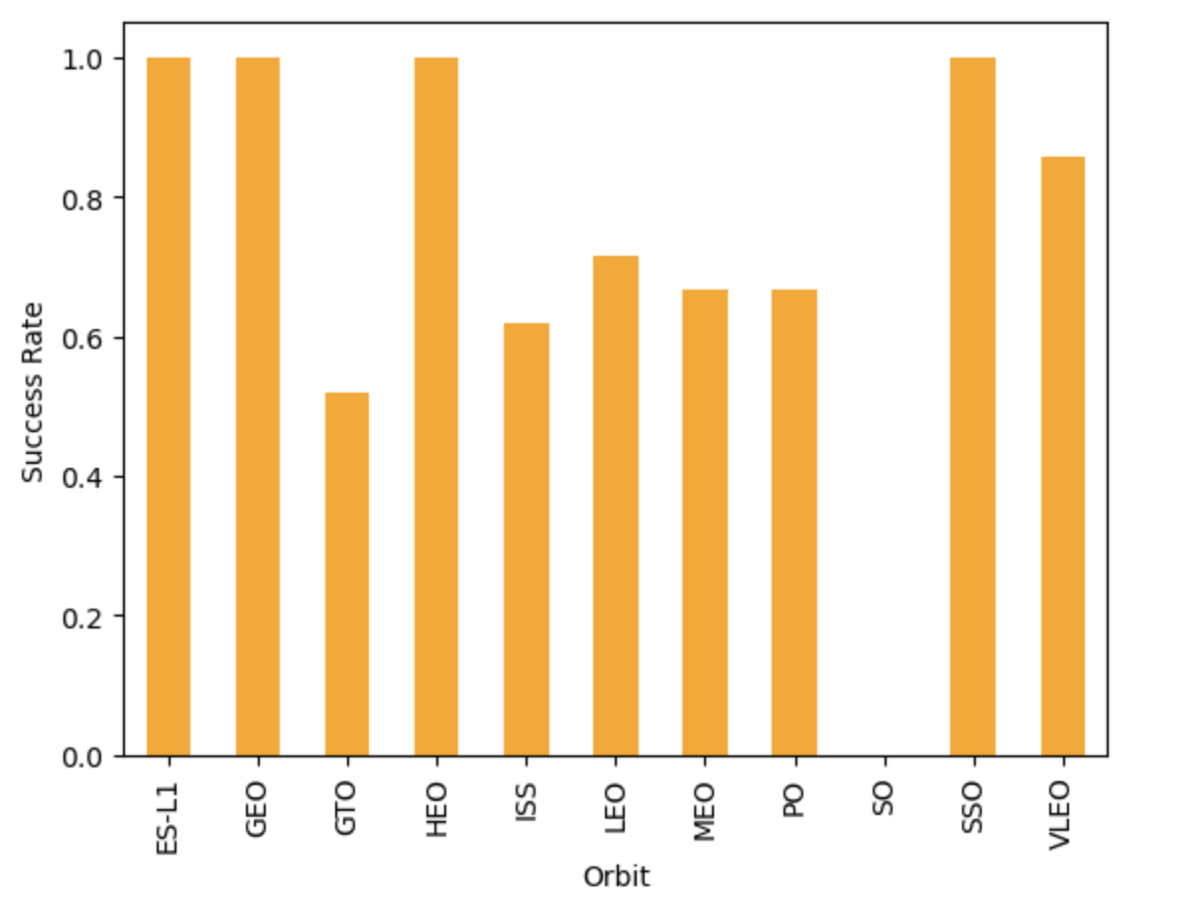
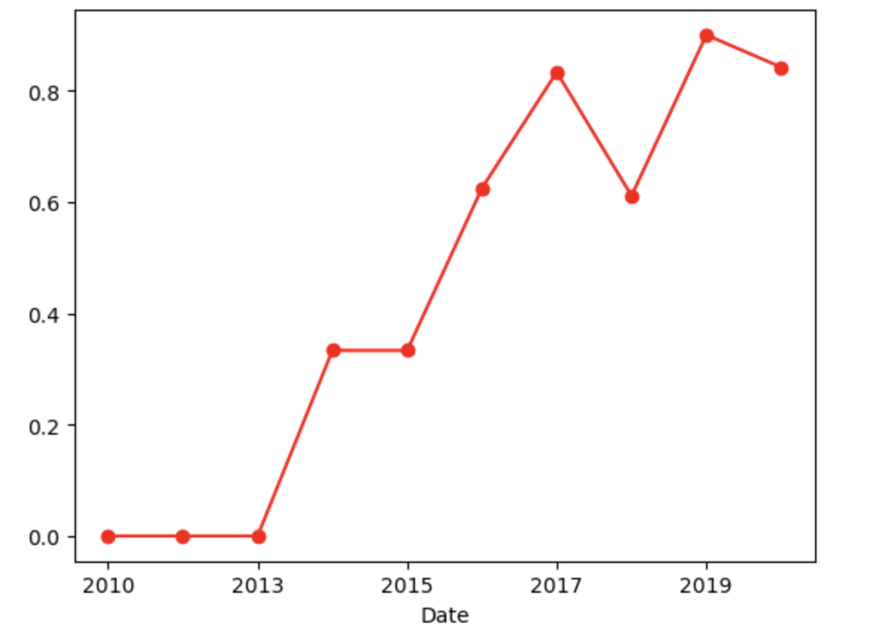
EDA with Data Visualization
We explored the data by visualizing the relationship between flight number and launch Site, payload and launch site, success rate of each orbit type, flight number and orbit type, the launch success yearly trend.
Link:https://github.com/Rubina15Parveen/IBMCertificationForDataScience/blob/main/IBM%20Capstone%20Project/4.1%20EDA%20with%20Visualization.ipynb

Slide 12
EDA with SQL
Loaded the SpaceX dataset into a PostgreSQL database using inline SQL in Jupyter notebook.
Applied EDA with SQL to get insight from the data. Wrote queries to find out for instance:
The names of unique launch sites in the space mission.
The total payload mass carried by boosters launched by NASA (CRS)
The average payload mass carried by booster version F9 v1.1
The total number of successful and failure mission outcomes
The failed landing outcomes in drone ship, their booster version and launch site names.
Link: https://github.com/Rubina15Parveen/IBMCertificationForDataScience/blob/main/IBM%20Capstone%20Project/4.%20EDA%20SQL.ipynb

Slide 13
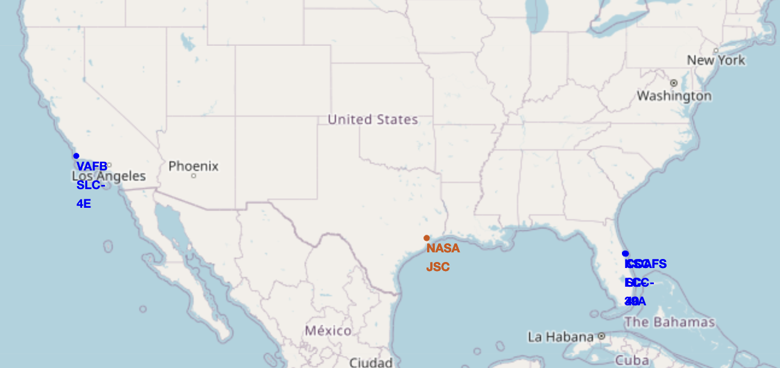
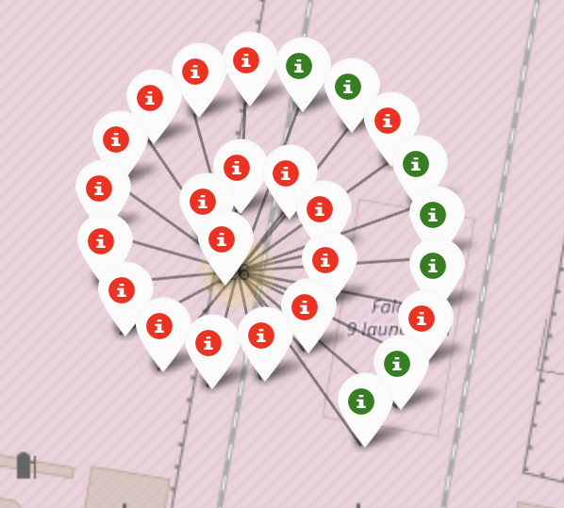
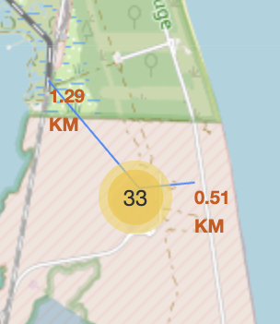
Build an Interactive Map with Folium
Map objects were added to improve understanding of SpaceX’s operational spread, highlight strategic launch and landing locations, and provide context for analyzing launch success rates, geographic constraints, and proximity to other locations or zones. The combination of markers, circles, lines, and popups makes the map interactive and informative, enhancing visual data exploration of SpaceX's launch data.
Link: https://github.com/Rubina15Parveen/IBMCertificationForDataScience/blob/main/IBM%20Capstone%20Project/5.%20Folium%20Map.ipynb

Slide 14
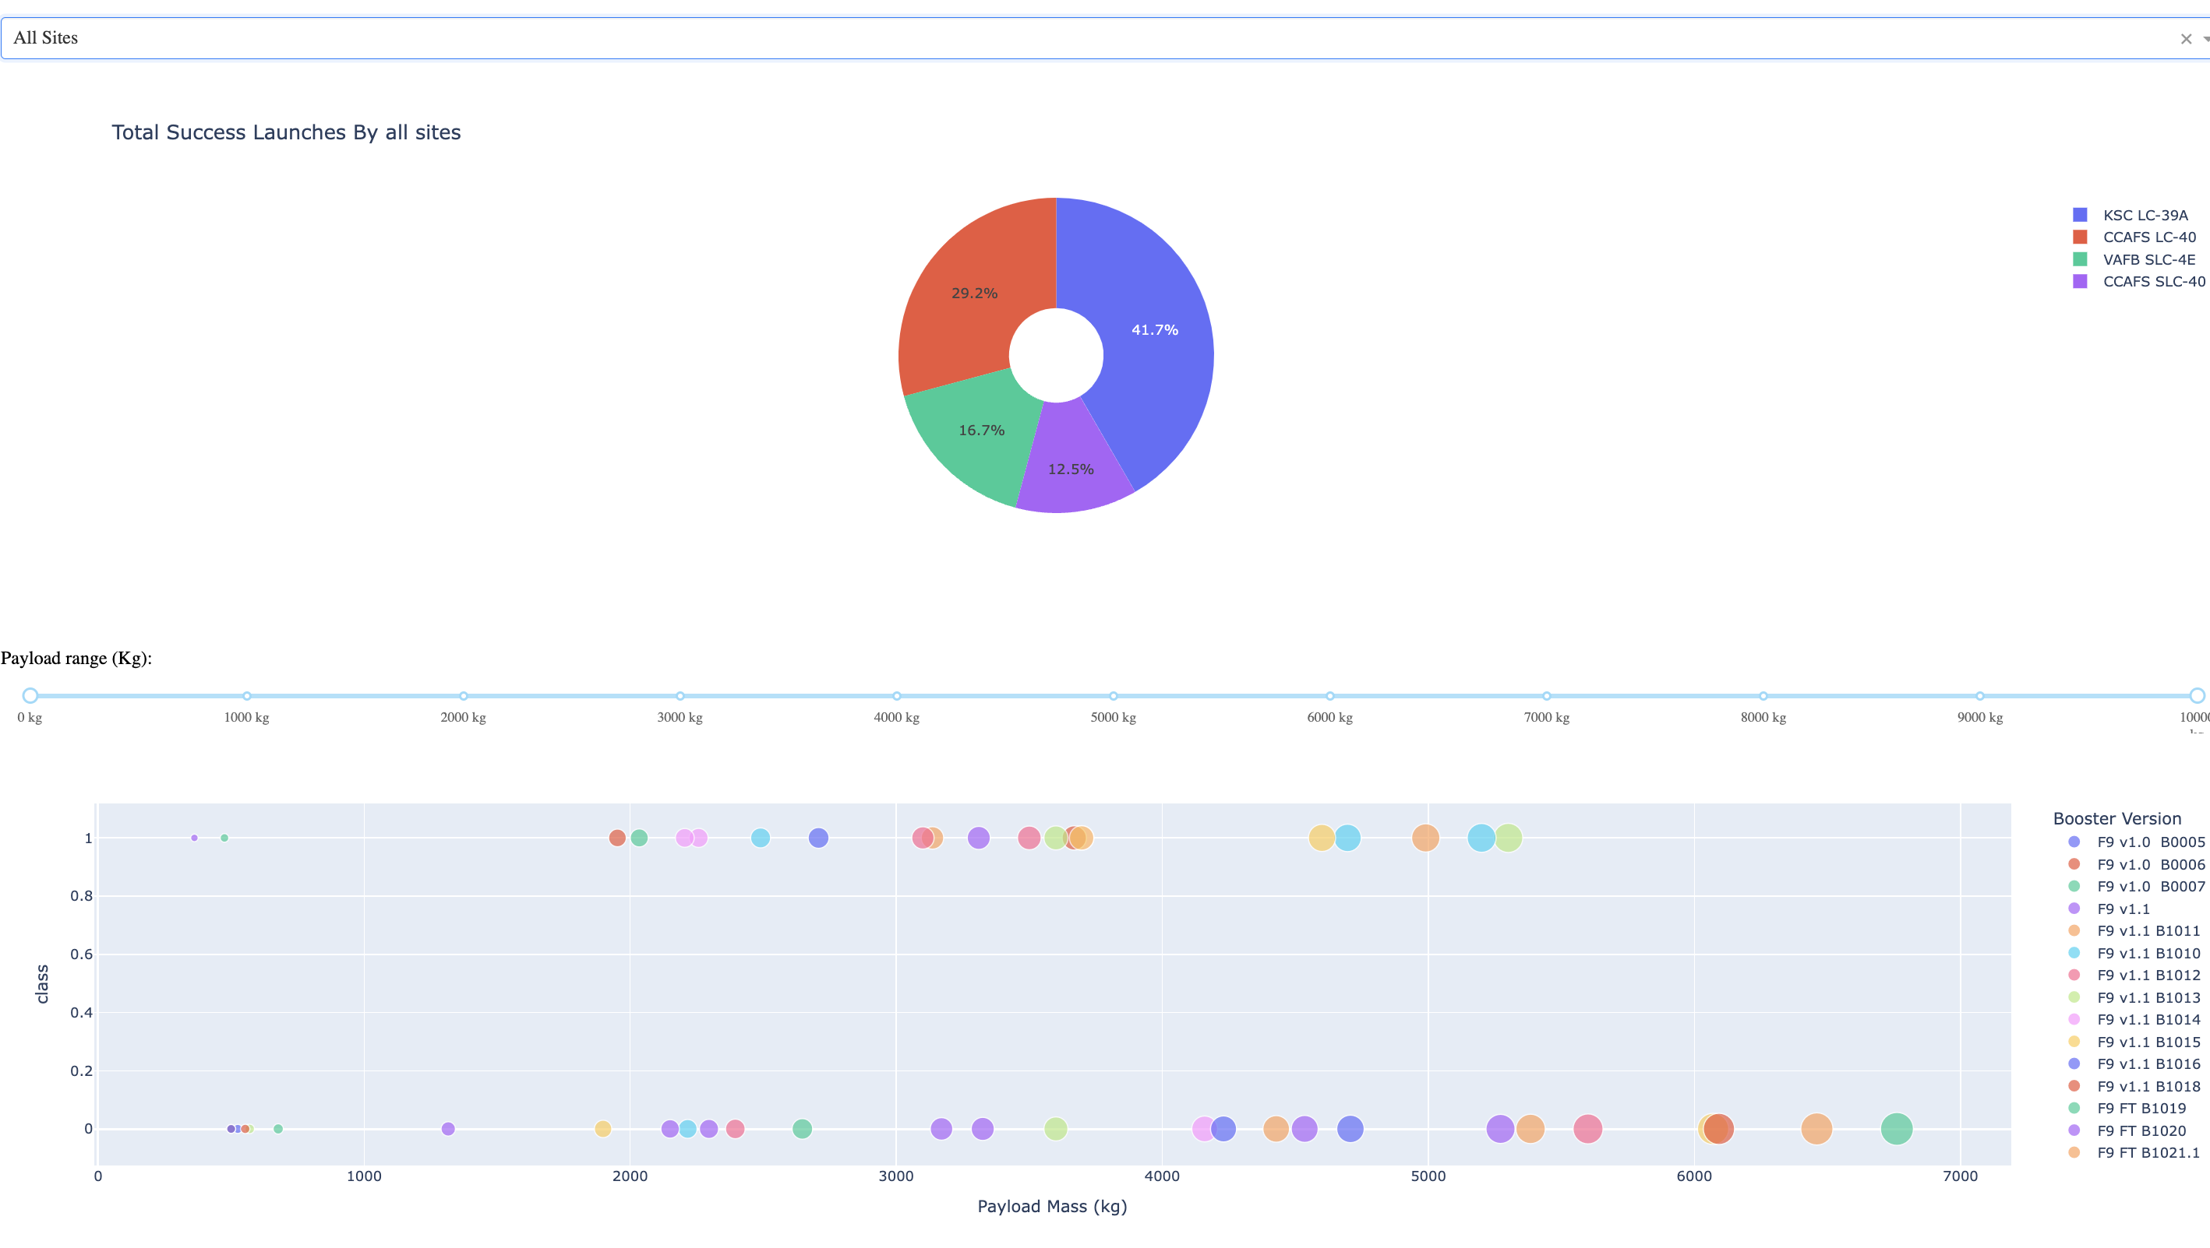
Build a Dashboard with Plotly Dash
Built an interactive dashboard with Plotly dash. Plotted pie charts showing the total launches by a certain sites. Plotted scatter graph showing the relationship with Outcome and Payload Mass (Kg) for the different booster version.
Link: https://github.com/Rubina15Parveen/IBMCertificationForDataScience/blob/main/IBM%20Capstone%20Project/7.%20spacex_dash_app.py

Slide 15
Predictive Analysis (Classification)
Loaded and preprocessed data using NumPy and Pandas, transforming it for optimal model training.
Split the data into training and testing sets to evaluate model performance effectively.
Built multiple machine learning classification models like decision trees, svm, logistic regression and k means and tuned hyperparameters using GridSearchCV.Enhanced model performance with feature engineering and additional tuning techniques.
Identified the highest-performing classification model based on accuracy as the primary metric.

Slide 16

Section 2

Slide 17

Flight Number vs. Launch Site
From the plot, we found that the larger the flight amount at a launch site, the greater the success rate at a launch site.

Slide 18

Payload vs. Launch Site
The greater the payload mass for launch site CCAFS SLC 40 the higher the success rate.

Slide 19
Success Rate vs. Orbit Type
From the plot, we can see that ES-L1, GEO, HEO, SSO, VLEO had the most success rate.

Slide 20

Flight Number vs. Orbit Type
The plot below shows the Flight Number vs. Orbit type. We observe that in the LEO orbit, success is related to the number of flights whereas in the GTO orbit, there is no relationship between flight number and the orbit.

Slide 21

Payload vs. Orbit Type
We can observe that with heavy payloads, the successful landing are more for PO, LEO and ISS orbits.

Slide 22
Launch Success Yearly Trend
From the plot, we can observe that success rate since 2013 kept on increasing till 2020.

Slide 23
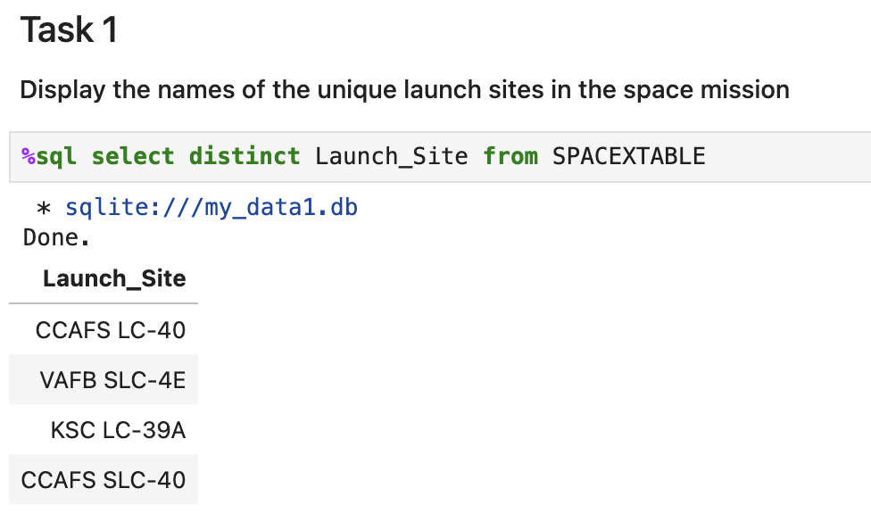
All Launch Site Names
These are the distinct unique sites

Slide 24
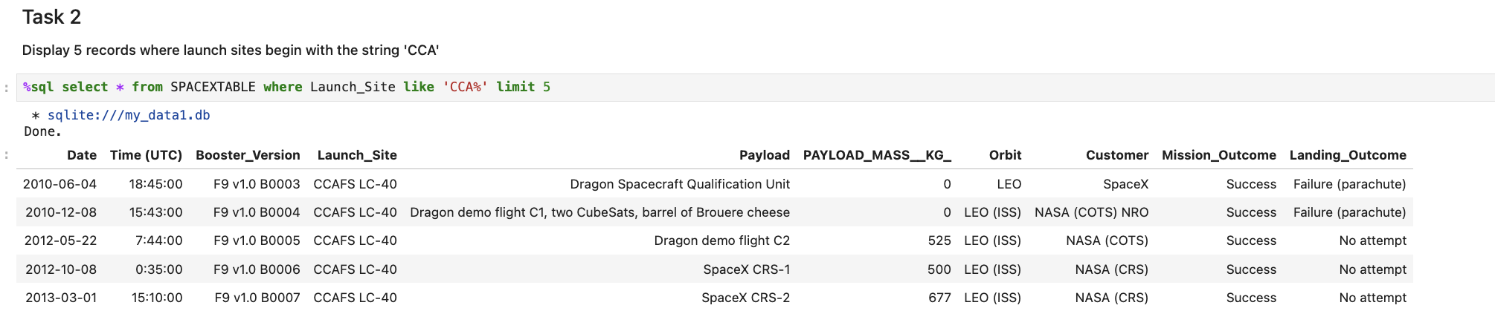
Launch Site Names Begin with 'CCA'
These are the records for 5 sites beginning with CCA

Slide 25
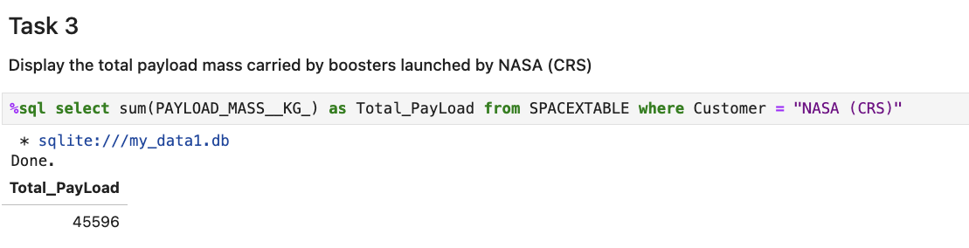
Total Payload Mass
We got a total of 45596 kg payload mass carried by boosters launched by NASA (CRS)

Slide 26
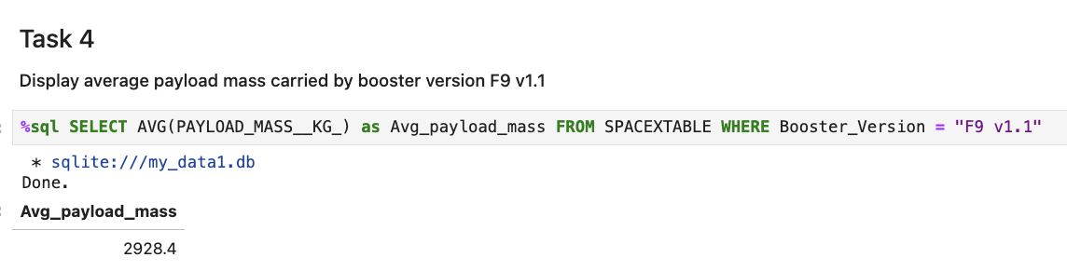
Average Payload Mass by F9 v1.1
Avg payload mass by F9v1.1 = 2928.4

Slide 27
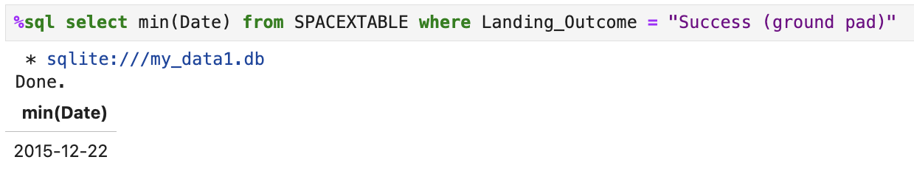
First Successful Ground Landing Date
First successful ground landing date was found to be : 22nd Dec 2015

Slide 28
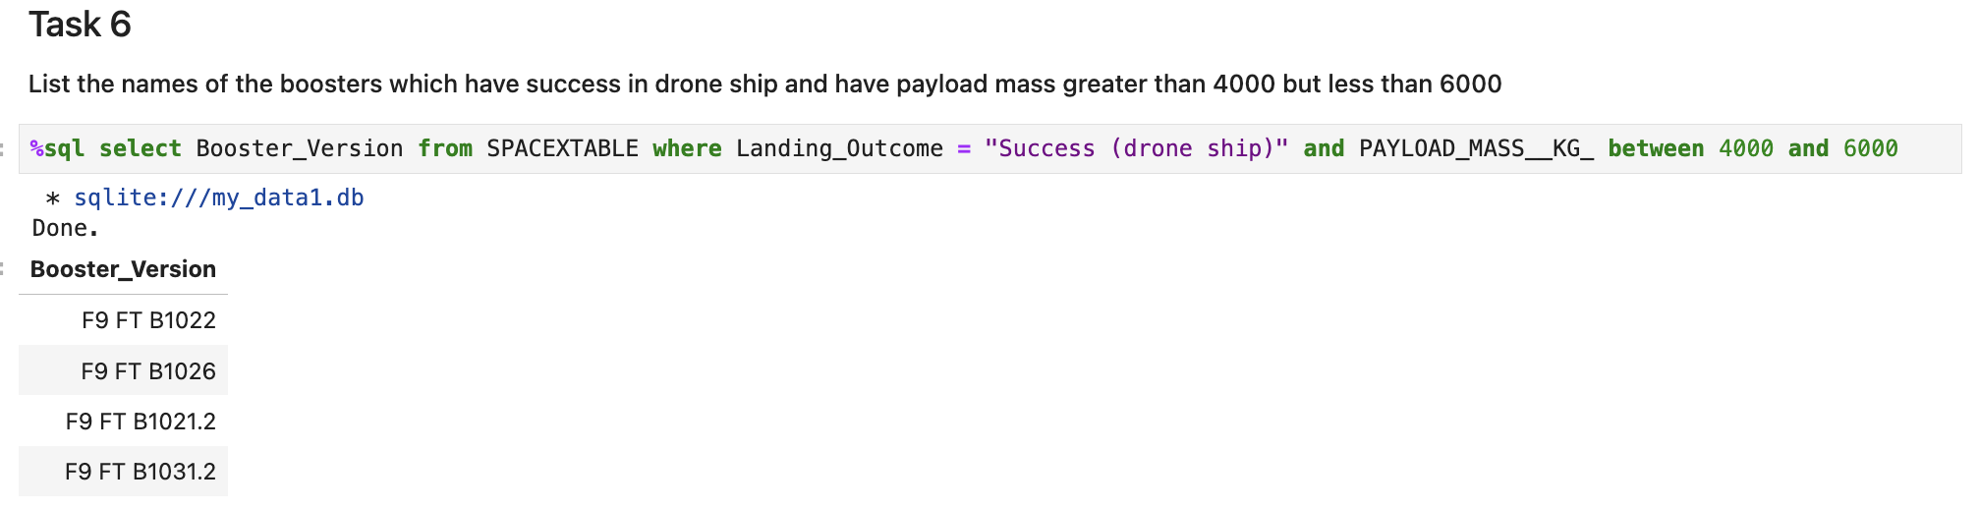
Successful Drone Ship Landing with Payload between 4000 and 6000
Names of boosters which have successfully landed on drone ship and had payload mass greater than 4000 but less than 6000 are:

Slide 29
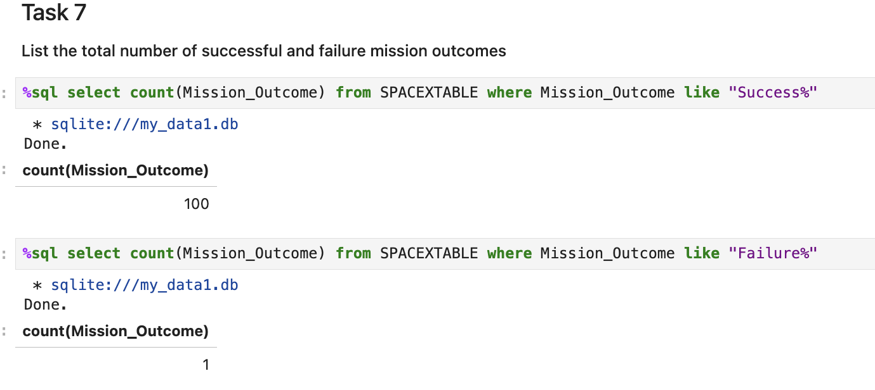
Total Number of Successful and Failure Mission Outcomes
Calculated the total number of successful and failure mission outcomes as follows:

Slide 30
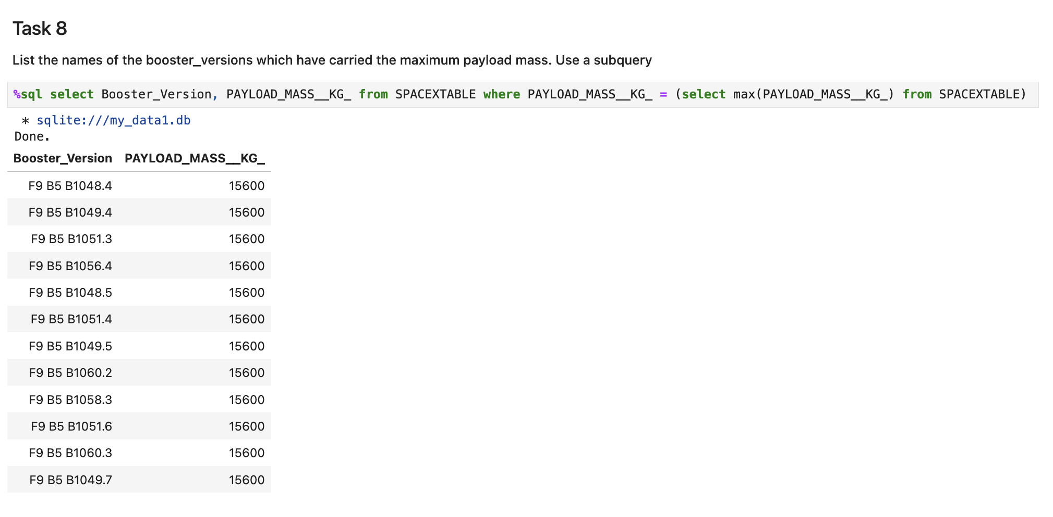
Boosters Carried Maximum Payload
List of the names of the booster which have carried the maximum payload mass

Slide 31
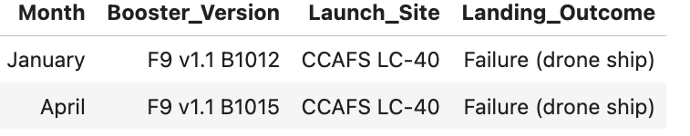
2015 Launch Records
List of the failed landing outcomes in drone ship, their booster versions, and launch site names for year 2015.

Slide 32
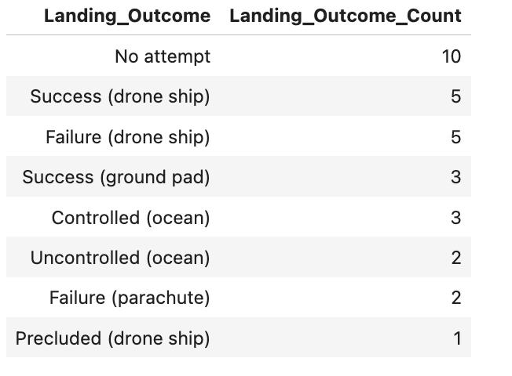
Rank Landing Outcomes Between 2010-06-04 and 2017-03-20
Rank of landing outcomes (such as Failure (drone ship) or Success (ground pad)) between the date 2010-06-04 and 2017-03-20, in descending order.

Slide 33

Section 3

Slide 34
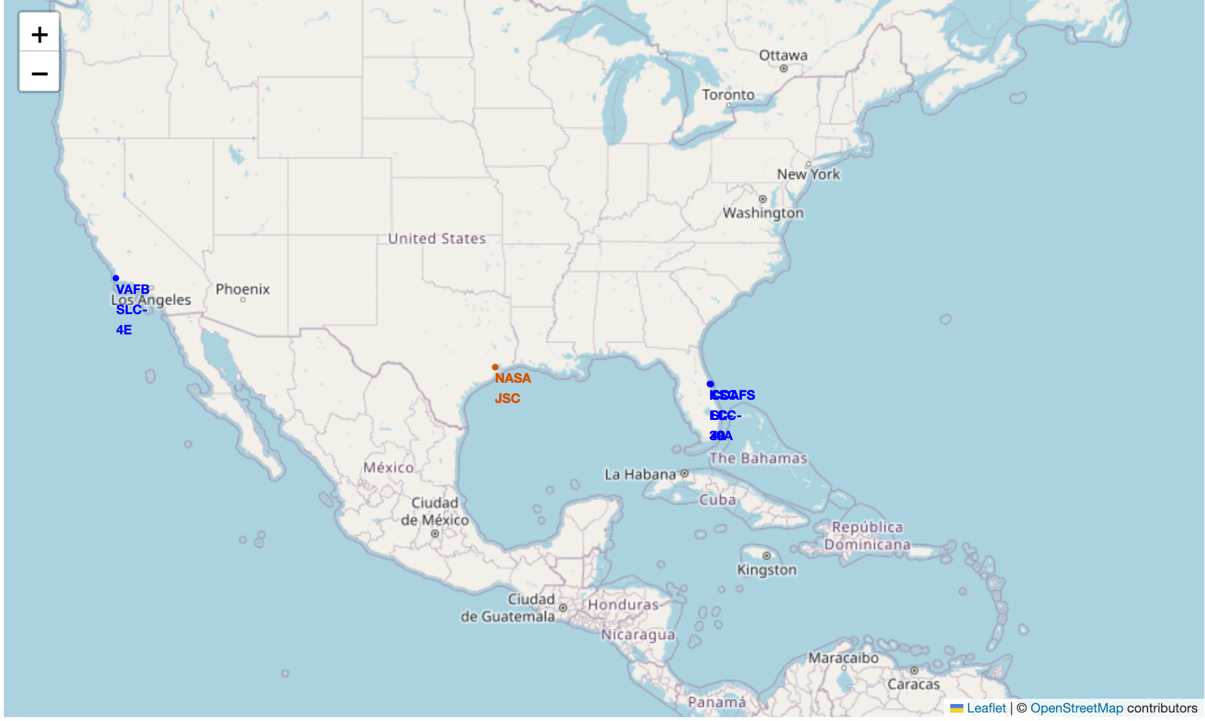
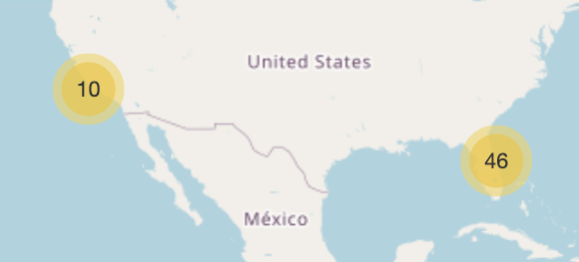
Launch site of SPACEX
The sites are situated in California and Florida which has proximity to the coastline. We can see the number of launches on both the sites.

Slide 35
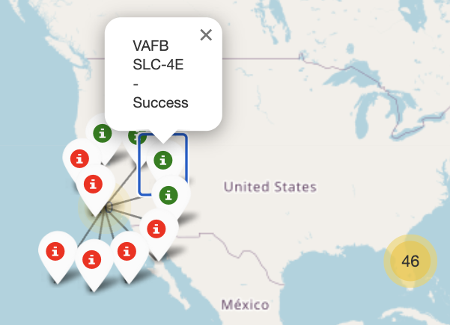
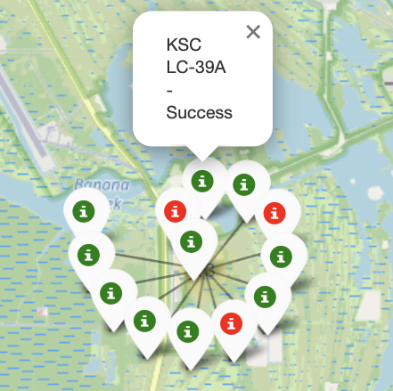
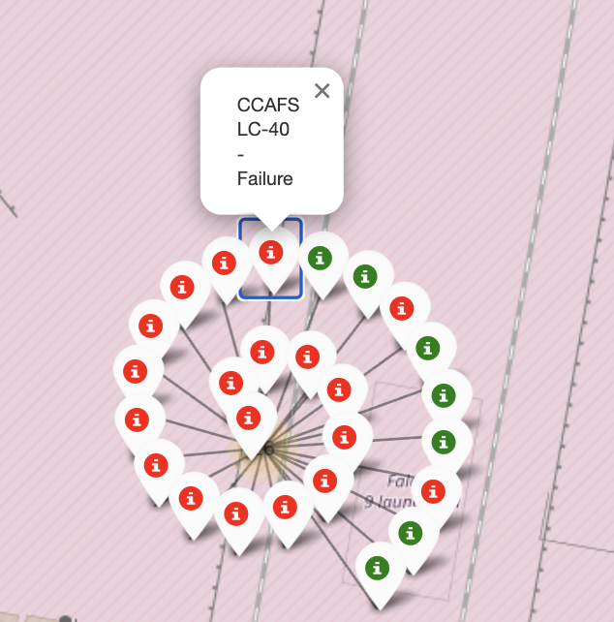
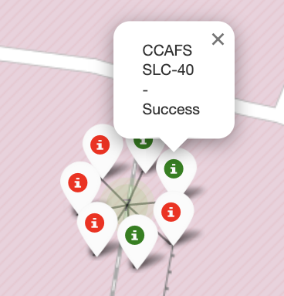
Launch outcomes of the sites
We can see the launch outcomes for the sites color coded as green - successful and red – unsuccessful
1st picture is of launch site in California and 2, 3, 4 are for sites in Florida.
1
2
3
4

Slide 36
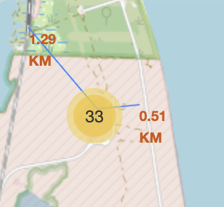
Launch site distance from the landmarks
Here is the map for distance from landmarks

Slide 37

Section 4

Slide 38
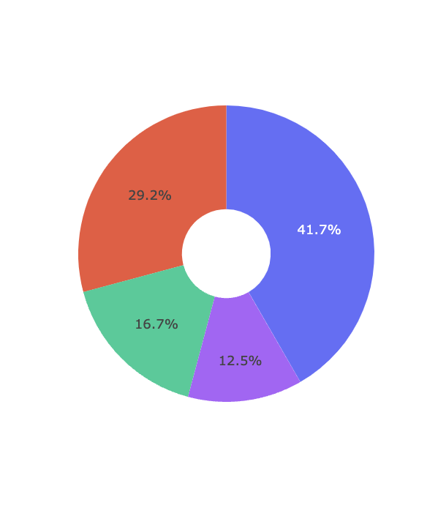
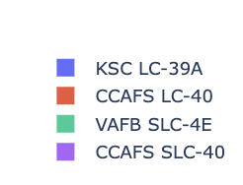
Pie chart showing the success percentage achieved by each launch site
We can see the most successful launches are achieved by KSC LC -39A site in Florida.
On second number we have CCAFS LC – 40 from Florida.
In total successful launched have been made from Florida site

Slide 39
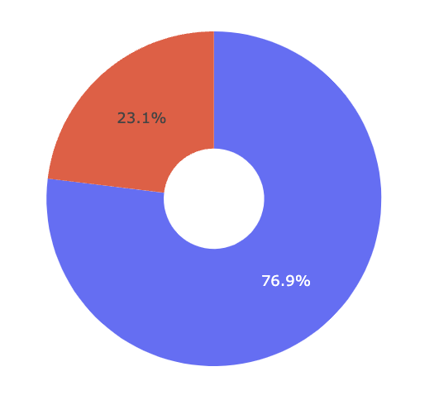
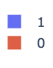
Highest launch success ratio
We can see that the KSC LC-39A site in Florida has a success ratio of 76.9%. Which is highest amongst all sites.

Slide 40
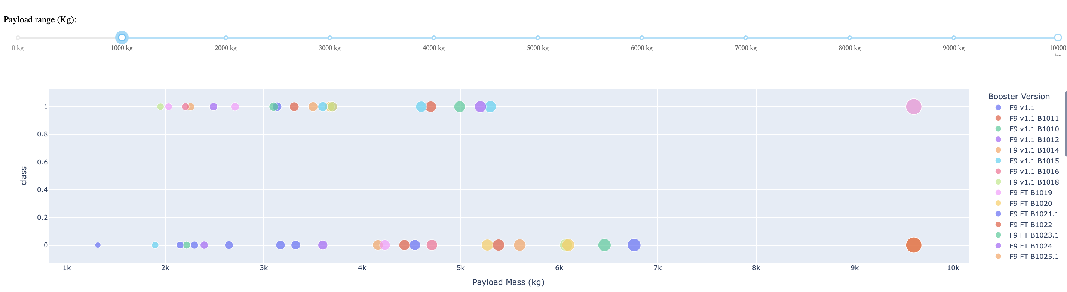
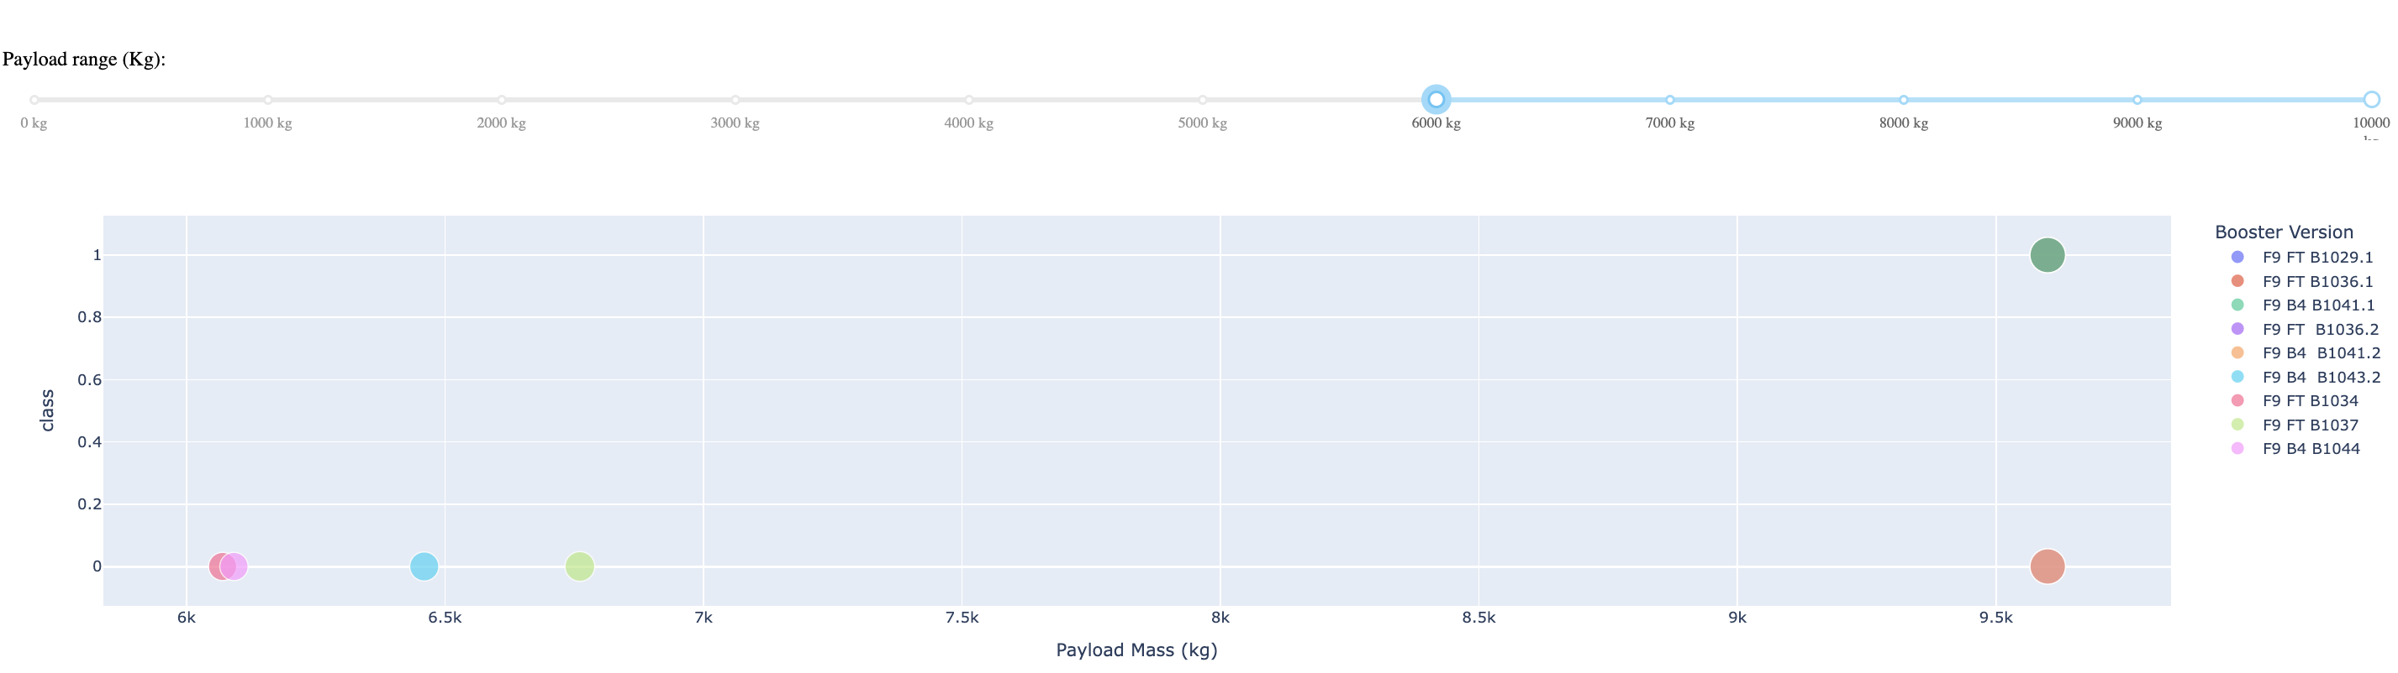
Scatter plot of Payload vs vs Launch Outcome for all sites
1000kg
Success rate of low weight payloads is higher than high weight payload
6000kg

Slide 41

Section 5

Slide 42
Classification Accuracy
Decision Tree gives the highest Accuracy.

Slide 43
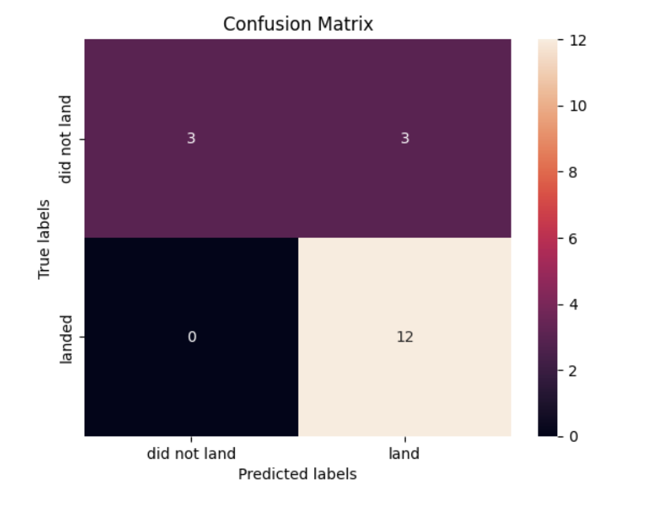
Confusion Matrix
We can see that the confusion matrix of Decision Tree predicts the highest number of successful landings. The major problem is the false positives .i.e., unsuccessful landing marked as successful landing by the classifier.

Slide 44
Conclusions
Higher launch volumes at a site correlate with increased success rates, indicating a positive relationship between flight frequency and launch success.
The launch success rate showed a steady increase from 2013 to 2020.
Orbits such as ES-L1, GEO, HEO, SSO, and VLEO achieved the highest success rates among all orbit types.
The Kennedy Space Center’s LC-39A site recorded the highest number of successful launches compared to other launch sites.
The Decision Tree Classifier emerged as the best-performing machine learning algorithm for predicting launch success in this analysis.

Slide 45


